Slide 1


DO or DIE:
A DATA EXPLORATION OF CARBON EMISSION TO
IMPROVE THE IMPLEMENTATION OF
NDC IN THE PHILIPPINES
TEAM CODE POLTERGIEST
ABRAHAM, JHON MARTIN
ESGUERRA, CHARLES IVAN
Guerra, Mariel
Ilagan, Renz Andrew
Salazar, Jhon Francis

Slide 2


SUSTAINABLE DEVELOPMENT GOAL

Slide 3

Rimberio Co
SAVE ENVIRONTMENT
THE WORLD TODAY
...
“For someone to risk their career, to risk their freedom, to risk even their life, it creates a very strong statement that what they’re fighting for is important,” Peter Kalmus, a climate scientist
https://youtube.com/shorts/hDOHahIleaY?feature=share

Slide 4
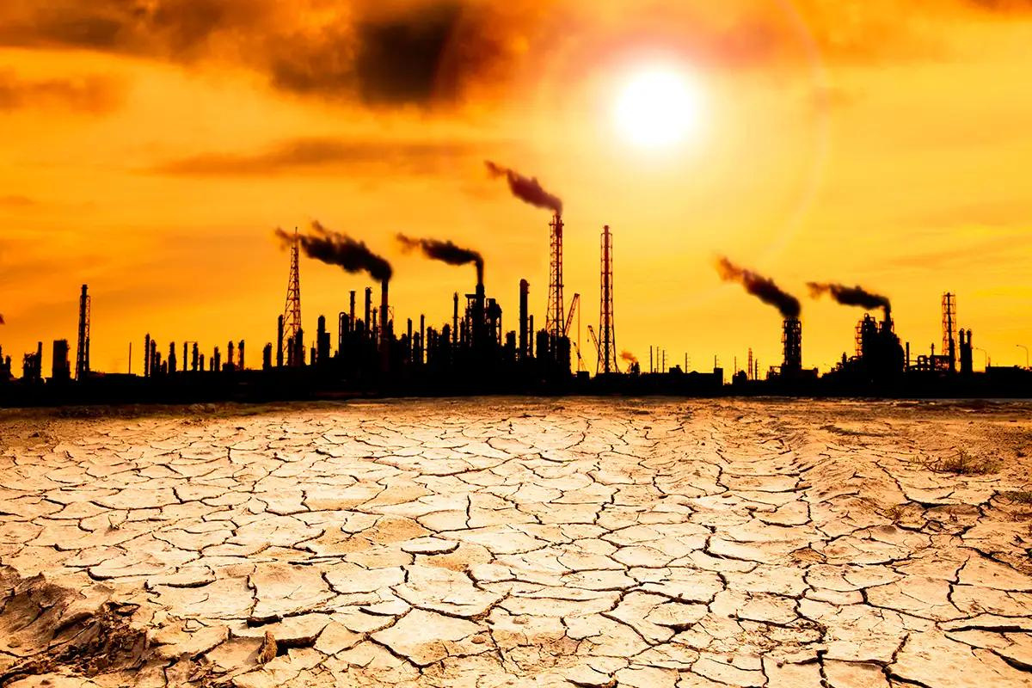
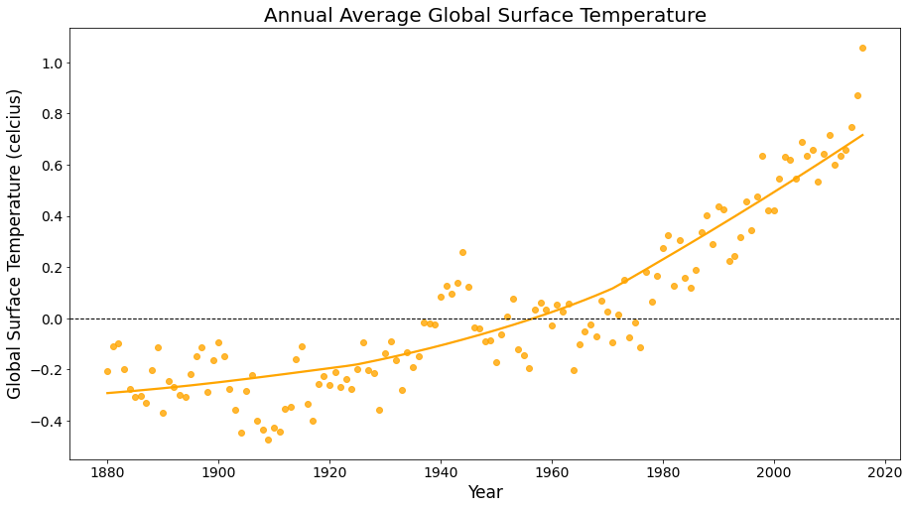
https://images.app.goo.gl/9ejHMGG1ecu9wQET9

Slide 5

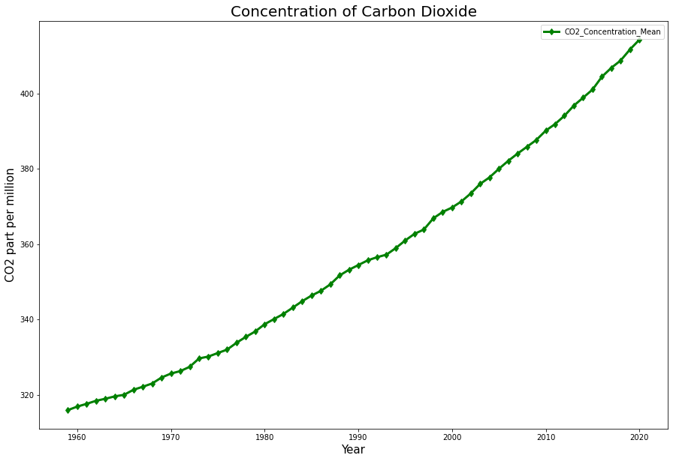
https://images.app.goo.gl/5whiQ1MPwkY926se9

Slide 6
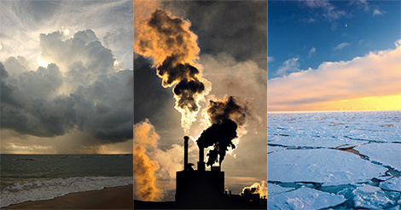
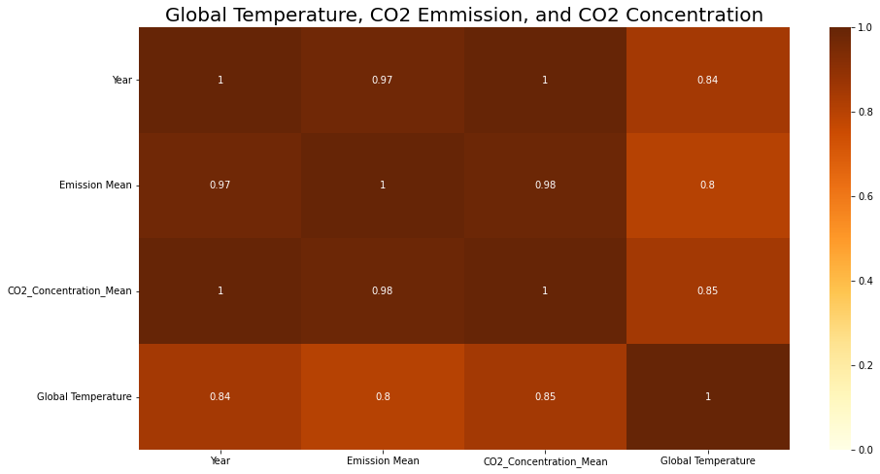
https://images.app.goo.gl/BGcMXQgPoVVEJ5tUA

Slide 7
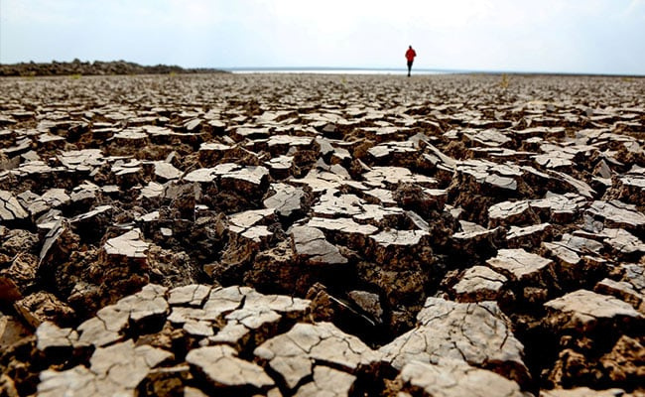
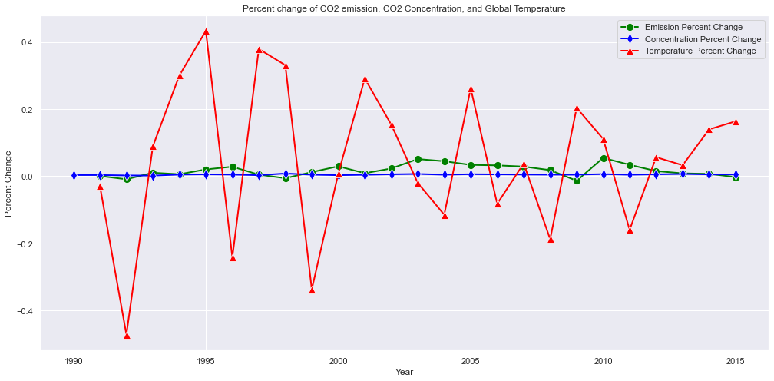
https://images.app.goo.gl/YMkWGsjvB1rfXxSC7

Slide 8

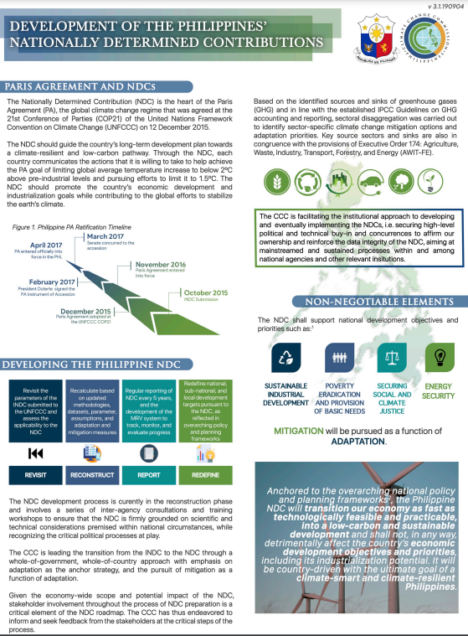
NATIONAL DETERMINED CONTRIBUTION (NDC)
The administration of President Rodrigo Duterte presented the Philippine MDC, however, the aforementioned NDC lacks clarity in terms of how it would be implemented and attained.
https://climate.gov.ph/public/ckfinder/userfiles/files/Knowledge/NDC%20Briefer%203_1%20Optimized-page1_1600062989.pdf

Slide 9
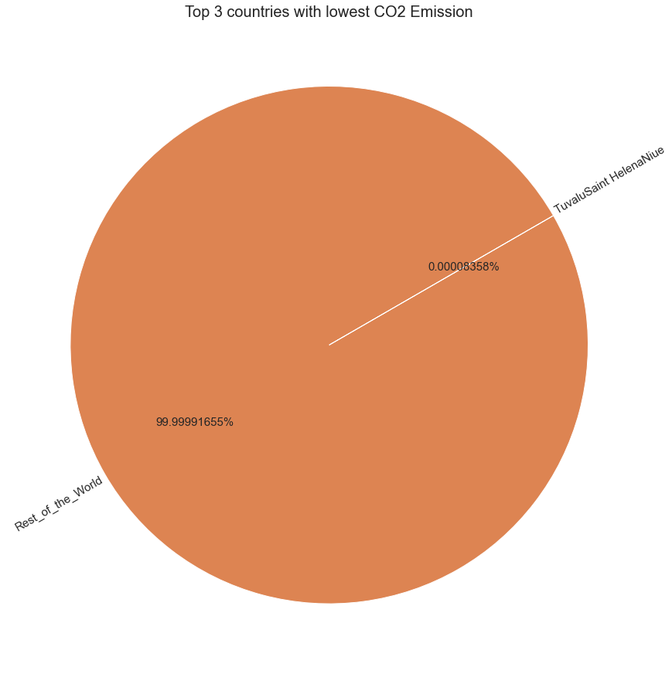



SAVE ENVIRONTMENT
TOP 3 COUNTRIES WITH LOWEST CO2 EMISSION
TUVALU
https://images.app.goo.gl/TS6Y2cSAe6xWsoZHA
SAINT HELENA
NIUE
https://images.app.goo.gl/tn9enS4DmUt2Fz4b6
https://images.app.goo.gl/mEgPXYxobio2fyLJ9

Slide 10
Laws, Policies and Plans
TUVALU
is policy that defines the role of Department of Environment to respont on environmental challenges
Environment protection Act (2008)
Climate Change Resilience Act
is policy that defines a strong climate change response to improve the resiliency of Tuvalu towards climate change
national Adaptation Programme of Action (2007)
this program determine the participation in decision making and promotes he awareness of the citizens for climate adaptation
Climate Chnage Policy (2012-2021)
is the policy that strengthens the communication system in the country in order to address the climate issues
National Strategy for Sustainable Development- 'Te Kete' (2021-2030)
one of the key polic that improves the resiliency of the country towards climate change

Slide 11
Laws, Policies and Plans
SAINT HELENA
this project aims to lessen the reliance of Saint Helena to fossil fuels as energy source but rather they use solar and wind to obtain renewable energy
Energy: 100% Renewable Saint Helena
NIUE
Pacific Adaptation to Climate Change Niue
this policy improves the resilience in three sectors: water resource, food and coastal zone

Slide 12

Rimberio Co
THANK YOU
WWW.REALLYGREATSITE.COM
Presentation Design

